Slide 1
Cloud Computing
SEWP ZG527

Slide 2



Hadoop
Name of the elephant!!
Notes:
RL 8.1

Slide 3
Hadoop common Component
MapReduce – offline computing engine (Data Processing Framework)
HDFS – Hadoop Distributed file system (Data Storage Framework
Frameworks like Hbase, Pig and Hive have been built on top of Hadoop.
Pig is a dataflow language and execution environment over Hadoop.
Hbase is a distributed key-value store which supports SQL-like queries similar to Google’s BigTable
Hive is a distributed data warehouse to manage data stored in the Hadoop File System.
Notes:
RL 8.2

Slide 4
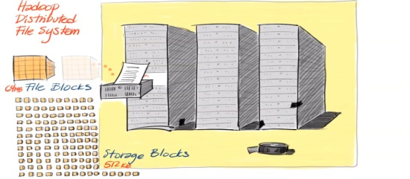
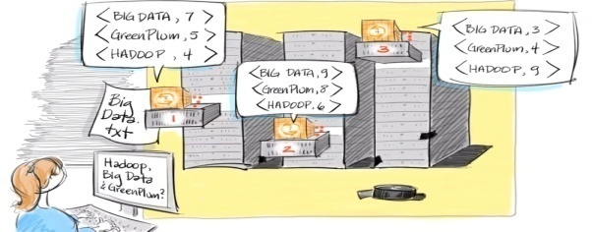
MapReduce (Data Processing Framework)
MapReduce
Software Framework for easily running applications
Processes large amount of data in parallel
Using large clusters having thousands of nodes
Nodes of commodity hardware
In a reliable and fault-tolerant manner

Slide 5
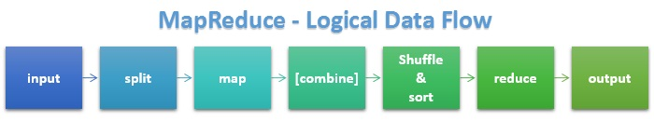
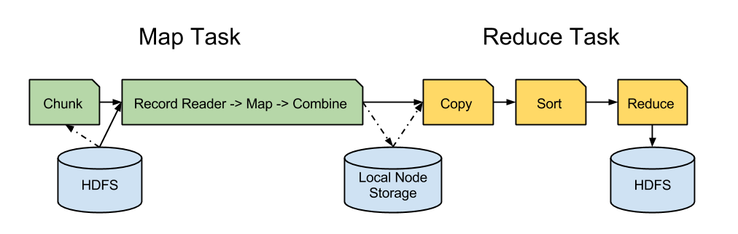
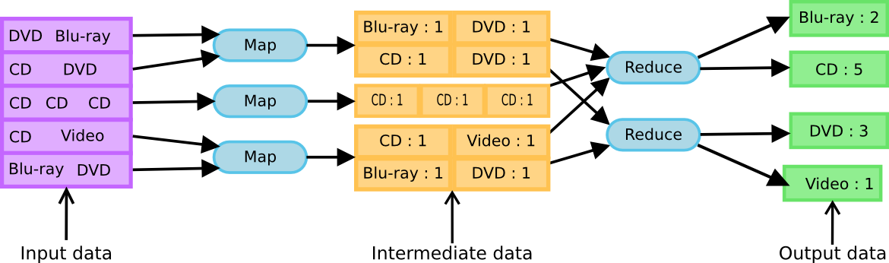
MapReduce Processing flow
Logical flow:
Two phases
Example:

Slide 6
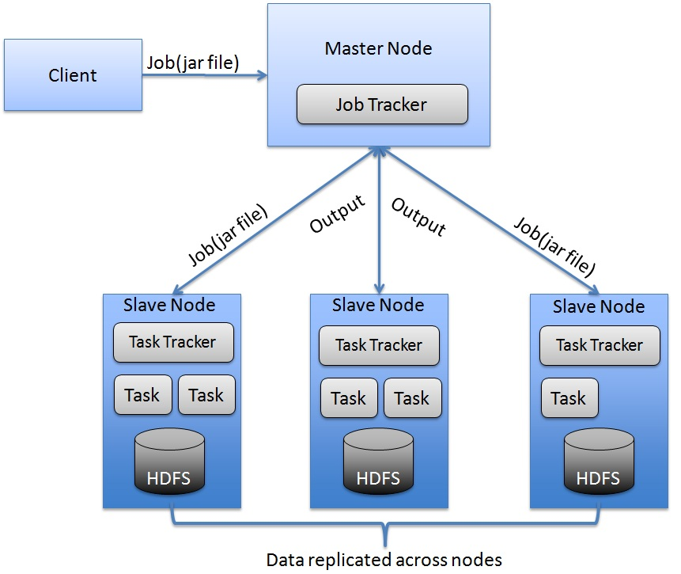
Architecture Overview
blog.raremile.com

Slide 7
Architecture (cont.)
NameNode/ Master Node:
Stores metadata for the files, like the directory structure of a typical FS.
The server holding the NameNode instance is quite crucial, as there is only one.
Transaction log for file deletes/adds, etc.
Handles creation of more replica blocks when necessary after a DataNode failure
DataNode/ Slave Node:
Stores the actual data in HDFS
Can run on any underlying filesystem (ext3/4, NTFS, etc)
Notifies NameNode of what blocks it has
NameNode replicates blocks 2x in local rack, 1x elsewhere

Slide 8
Architecture (cont.)
The Job Tracker:
Central authority for the complete MapReduce cluster and responsible for scheduling and monitoring MapReduce jobs
Responds to client request for job submission and status
The Task Tracker:
Workers that accepts map and reduce tasks from job tracker, launches them and keeps track of their progress, reports the same to job tracker.
Keeps track of resource usage of tasks and kills the tasks that overshoots their memory limits

Slide 9
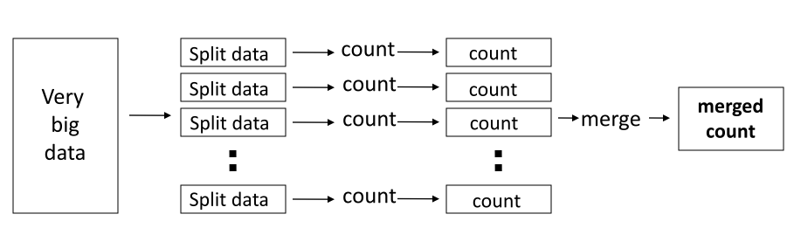
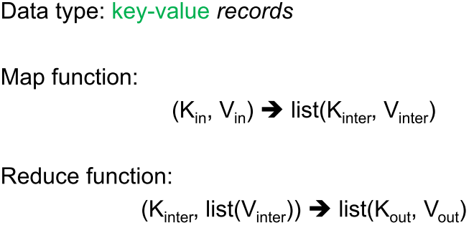
Distributed Word Count
MapReduce Programming Model

Slide 10
Example: Word Count
def mapper(line):
foreach word in line.split():
output(word, 1)
def reducer(key, values):
output(key, sum(values))

Slide 11
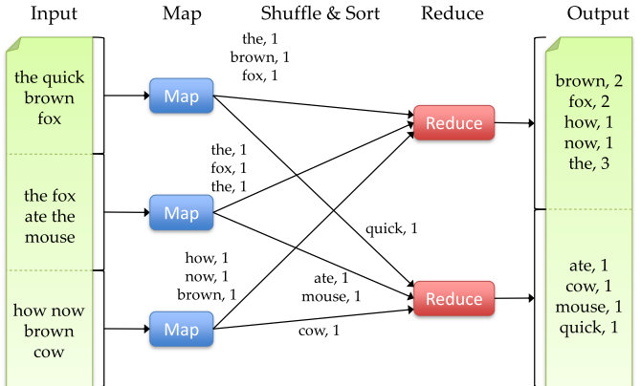
Word Count Execution

Slide 12
An Optimization: The Combiner
Local reduce function for repeated keys produced by same map
Decreases amount of intermediate data
• Example: local counting for Word Count:
An Optimization: The Combiner
def combiner(key, values):
output(key, sum(values))

Slide 13
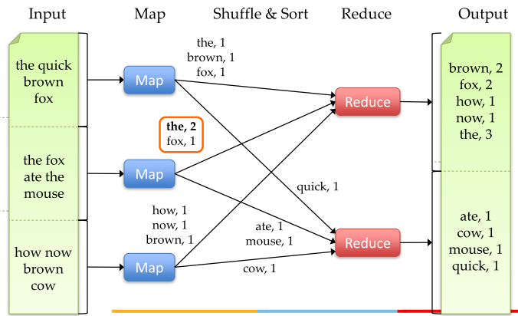
Word Count with Combiner

Slide 14
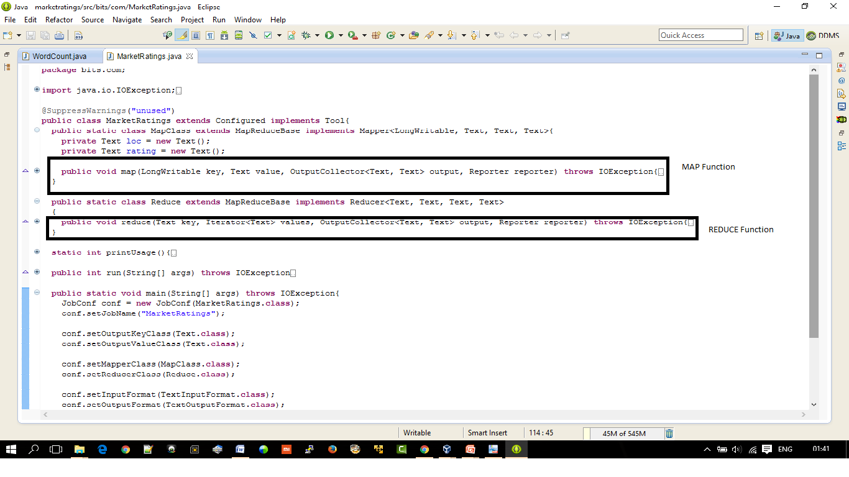
Snapshot of MarketRatings example and Program demo

Slide 15
MapReduce Execution Details
Mappers preferentially scheduled on same node or same
rack as their input block
– Minimize network use to improve performance
Mappers save outputs to local disk before serving to
reducers
– Allows recovery if a reducer crashes
– Allows running more reducers than # of nodes

Slide 16
Fault Tolerance in MapReduce
1. If a task crashes:
– Retry on another node
• OK for a map because it had no dependencies
• OK for reduce because map outputs are on disk
– If the same task repeatedly fails, fail the job or ignore that input block
2. If a node crashes:
– Relaunch its current tasks on other nodes
– Relaunch any maps the node previously ran
• Necessary because their output files were lost along
with the crashed node

Slide 17
Fault Tolerance in MapReduce
3. If a task is going slowly (straggler):
– Launch second copy of task on another node
– Take the output of whichever copy finishes first, and kill the other one
• Critical for performance in large clusters

Slide 18
Challenges of Cloud Environment
Cheap nodes fail, especially when you have many
– Mean time between failures for 1 node = 3 years
– MTBF for 1000 nodes = 1 day
– Solution: Build fault tolerance into system
Commodity network = low bandwidth
– Solution: Push computation to the data
Programming distributed systems is hard
– Solution: Restricted programming model: users write
data-parallel “map” and “reduce” functions and system
handles work distribution and failures

Slide 19
Hadoop
Thanks Hadoop

